Slide 1
Urban Shop Data Analysis
— Submitted by Shib Kumar Saraf

Slide 2
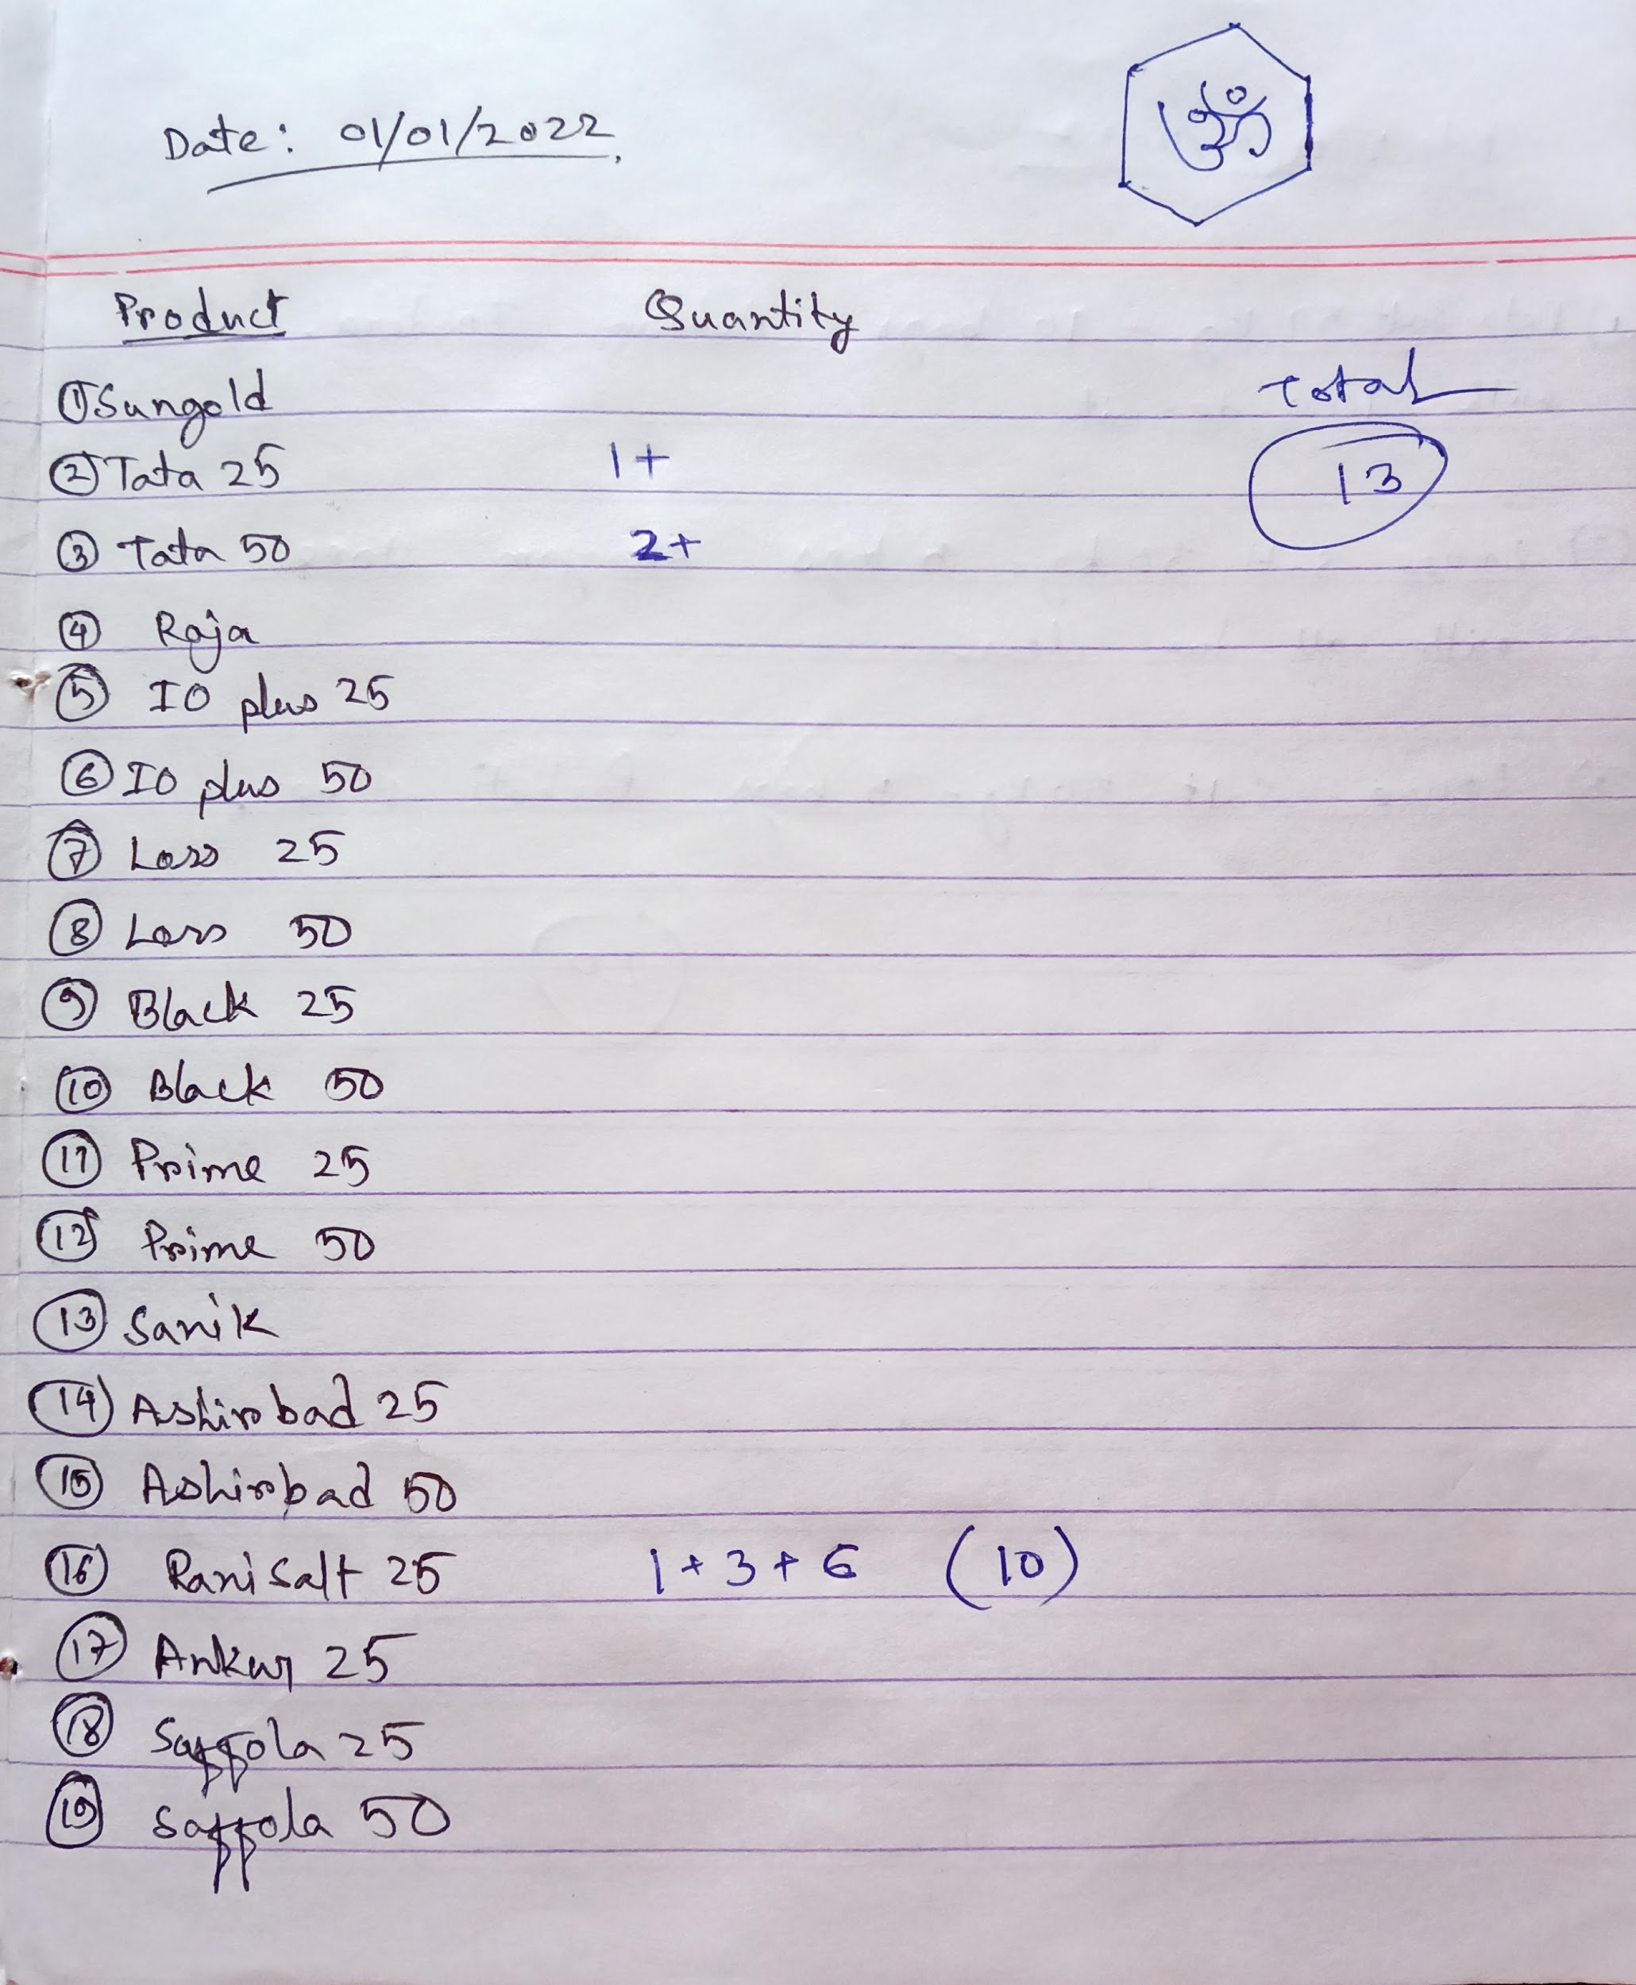
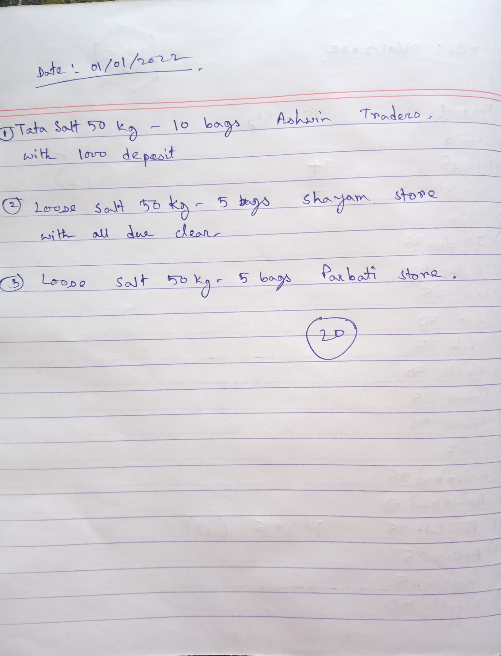
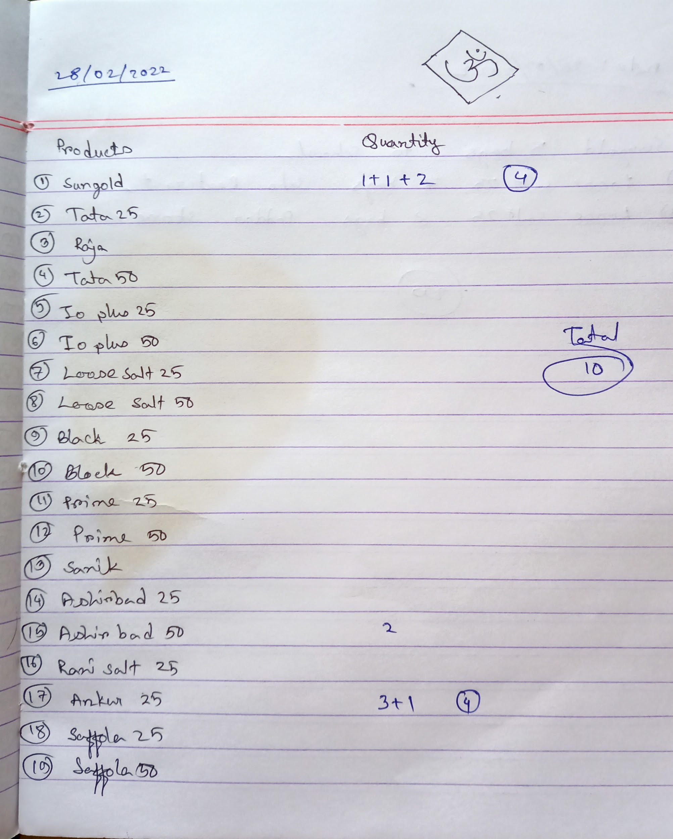
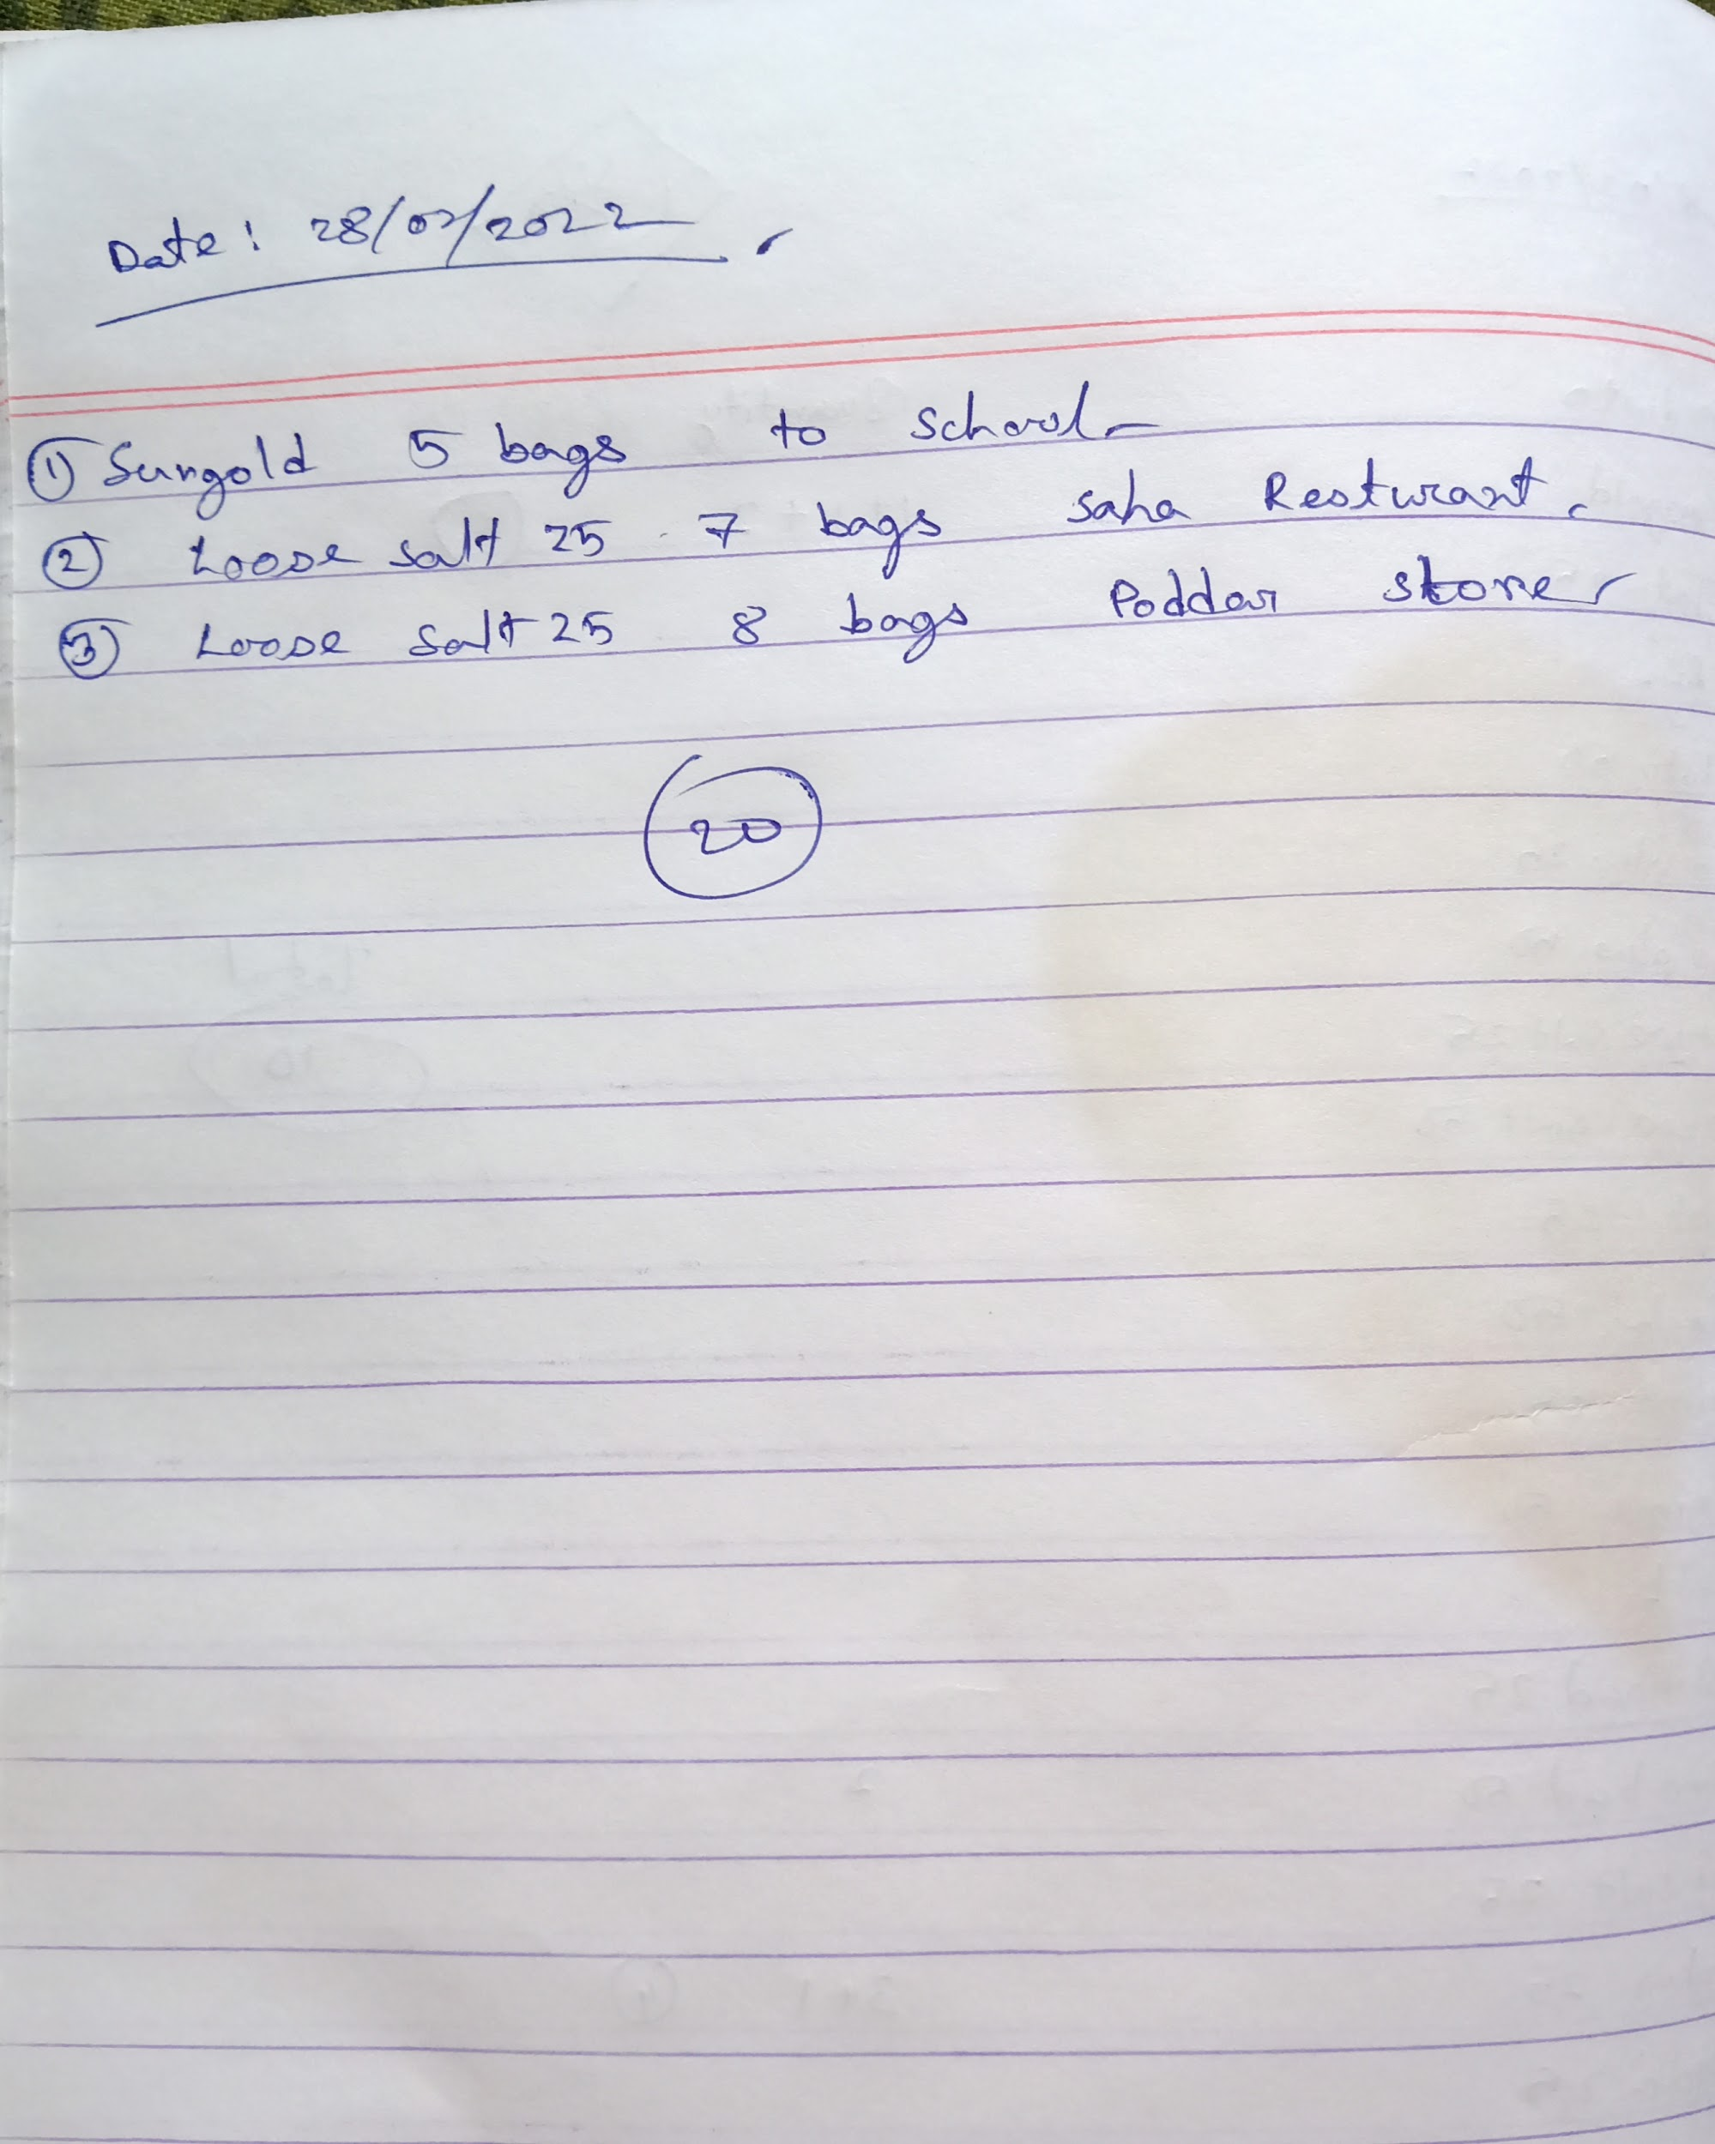
About The Business and Data Collection
‘ABC Salt Store’, is a 90 years old salt selling shop , located in XYZ, a small municipality town in XYZ district in Odisha and presently owned and run by the grandson of shop owner, with help of 3 external workers.
The store is known for Mainly selling in Wholesale Quantities but retail sales also happens & all sales transactions done in offline mode and maintained in pen-paper mode or in notebook.
There are two types of sales with different pricing per product : (1)credit sales (payment for this sales will come to shop later,this is mainly the wholesale & for known BtoB business ) , (2) sales in cash ( this is mainly the retail sales which maintains the cash liquidity in business).
Credit sales has some biases like business relations , old and permanent customers ,so sometimes it also contributes in retail sales .
I have collected the data on daily basis from 01/01/2022 to 28/02/2022 from their notebook and talking with them, then upload it on google sheets to work on it.

Slide 3
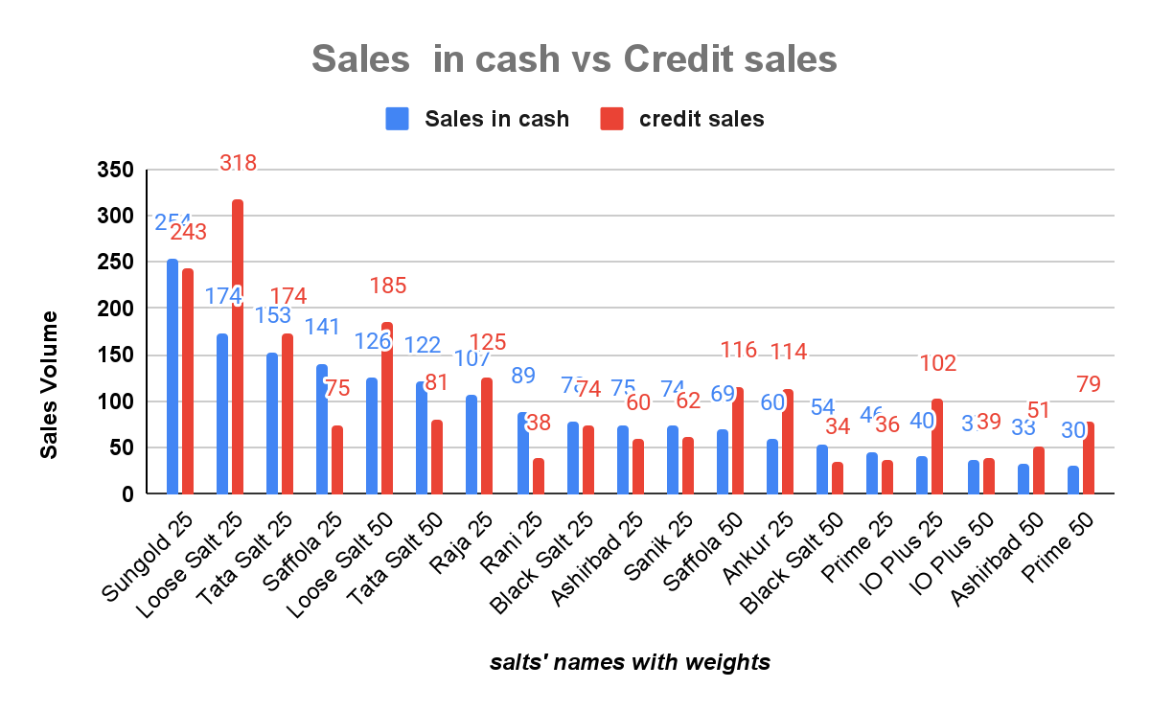
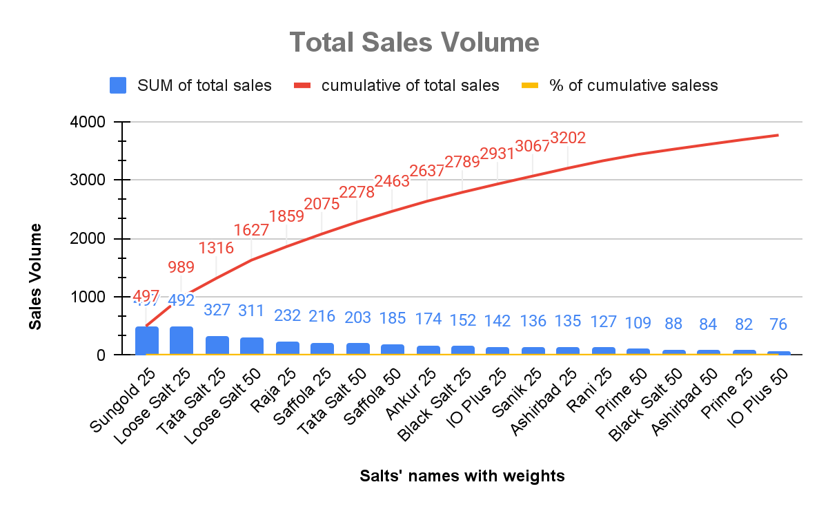
Data Analysis & Interpretation
In 2 months, Total sales Volume is 3768 bags and in which credit sale is 2006 bags and sales in cash is 1762 bags
Sungold of 25 kgs has the highest total sales Volume with cumulative sales of 13.19% but IO Plus of 50 kgs has the lowest total Sales.
In terms of total Credit sale Loose Salt of 25 kgs is in top with 318 bags but Black Salt of 50 kgs is in bottom.
In terms of total sales in cash , Sungold of 25 kg is in top with 254 bags but Prime of 50 kgs is in bottom.
Top 10 selling salts with their weights in terms of total sales are Sungold 25,Loose salt 25, Tata salt 25, Loose salt 50,Raja 25,Saffola 25, Tata salt 50,Saffola 50, Ankur 25,Black salt 25 respectively , and top 5 salts of total credit sales and sales in cash are also in this list.

Slide 4
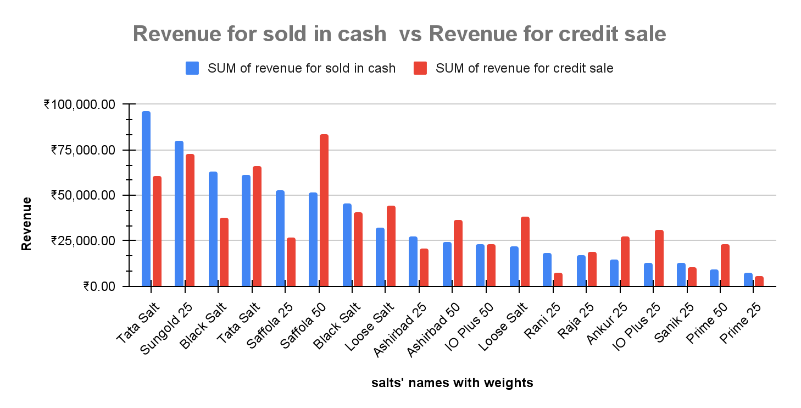
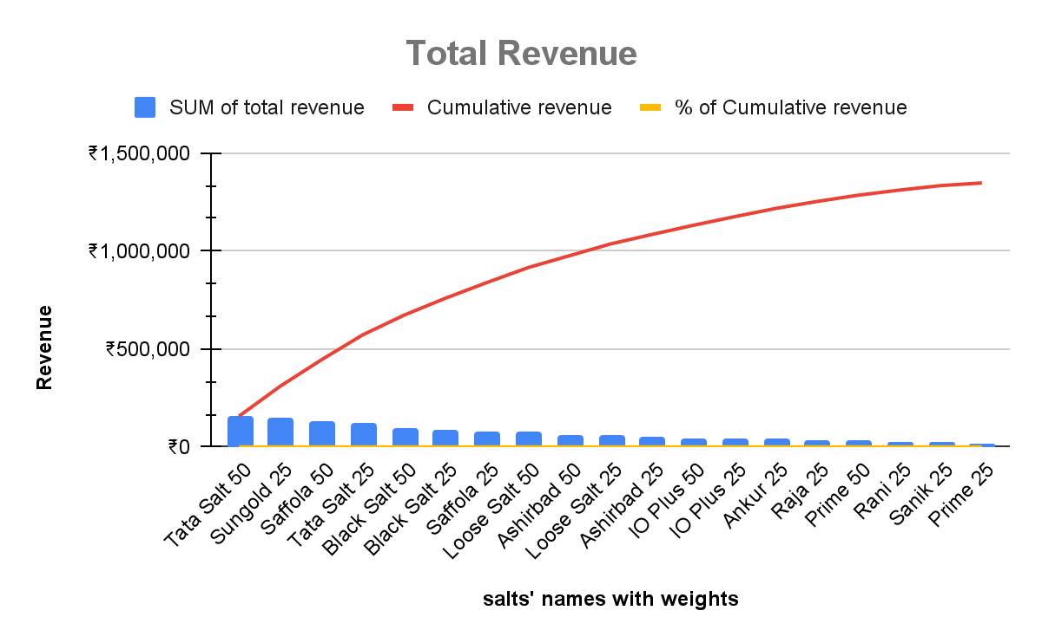
Data Analysis & Interpretation
In 2 months, Total Revenue is ₹1,347,096.90 and in which credit sales revenue is ₹675,280.00 and revenue for sales in cash is ₹671,816.90.
Tata Salt of 50 kgs has the highest total revenue with cumulative sales of 11.64% but Prime of 25 kgs has the lowest total revenue.
In terms of revenue in Credit sale, Saffola of 50 kgs is in top but Prime of 25 kgs is at bottom.
In terms of revenue for sales in cash , Tata salt of 50 kg is in top but Prime of 25 kgs is in bottom.
Top 10 selling salts with their weights in terms of total revenue are Tata salt 50,Sungold 25,Saffola 50,Tata salt 25,Black salt 50,Black salt 25,Saffola 25,Loose salt 50 ,Ashirbad 50, Loose salt 25 respectively , and top 5 salts of revenue for credit sales and sales in cash are also in this list.

Slide 5
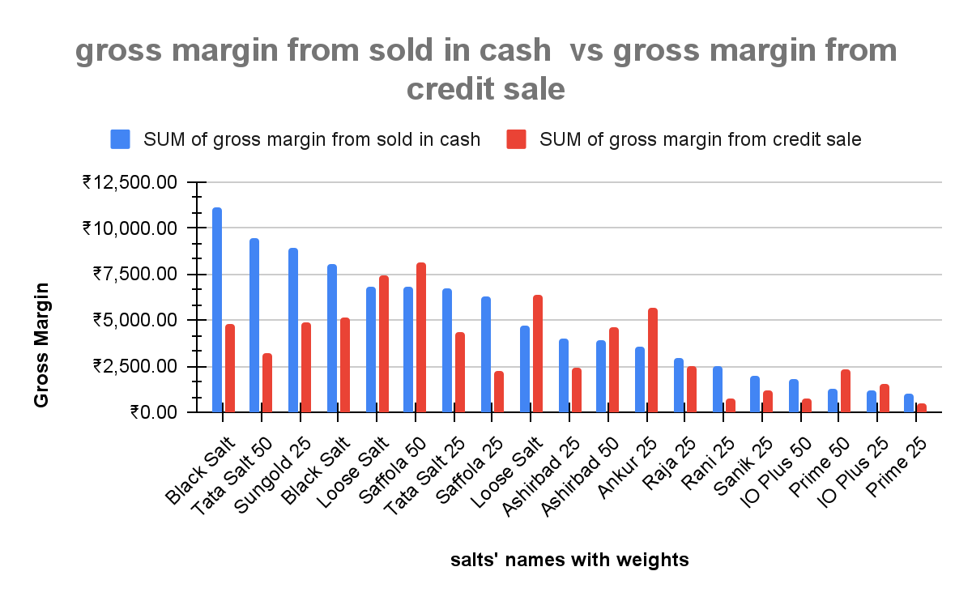
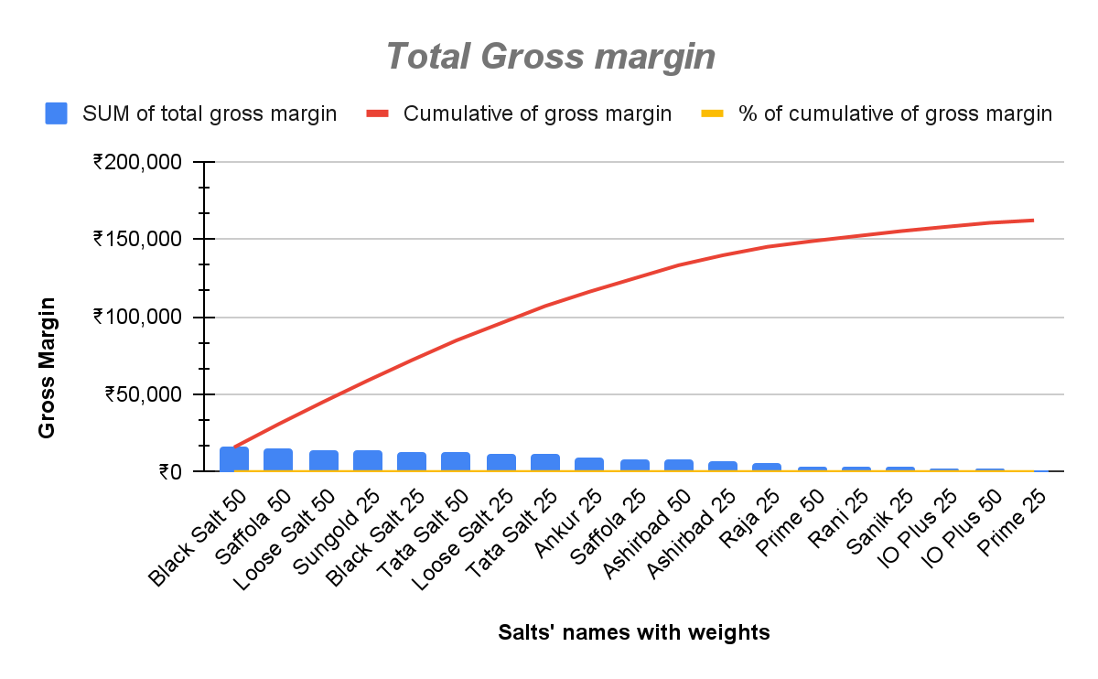
Data Analysis & Interpretation
In 2 months, Total Gross Margin is ₹162,131.90 and in which credit sales gross margin is ₹68,930.00 and gross margin for sales in cash is ₹93,201.90.
Black Salt of 50 kgs has the highest total Gross Margin with cumulative sales of 9.80% but Prime of 25 kgs has the lowest total Gross Margin.
In terms of Gross margin for Credit sale, Saffola of 50 kgs is in top but Prime of 25 kgs is at bottom.
In terms of Gross margin for sales in cash , Black salt of 50 kg is in top but Prime of 25 kgs is in bottom.
Top 10 selling salts with their weights in terms of total gross margin are Black salt 50,Saffola 50,Loose salt 50, Sungold 25,Black salt 25,Tata salt 50,Loose salt 25 ,Tata salt 25, Ankur 25 ,Saffola 25 respectively , and top 5 salts of Gross Margin for credit sales and sales in cash are also in this list.

Slide 6
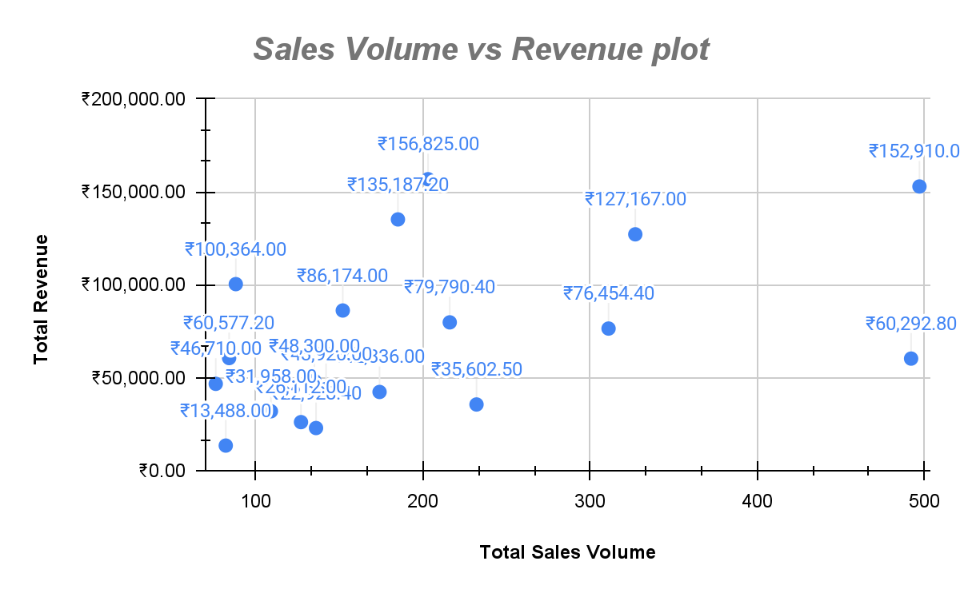
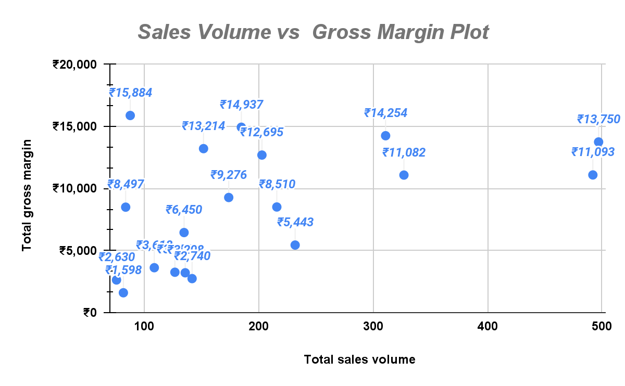
Data Analysis & Interpretation
From Sales Volume vs Revenue Plot :
Sungold of 25 kgs is most sold and revenue generating item in the shop with total sales volume of 497 bags and revenue of ₹152,910.00 .
Other salts having outstanding performance are Loose salt of 25 & 50 kgs ,Tata salt of 25 & 50 kgs .
From Sales Volume vs Gross Margin Plot :
Black salt of 50 Kgs,Saffola of 50 kgs Sungold of 25 kgs , Loose salt of 25 & 50 kgs ,Tata salt of 25 & 50 kgs are the outliers in the Sales Volume Vs gross margin graph.
Sungold of 25 kgs is most sold and Gross Margin generating item in the shop with total sales volume of 497 bags and gross margin of ₹13,750,

Slide 7
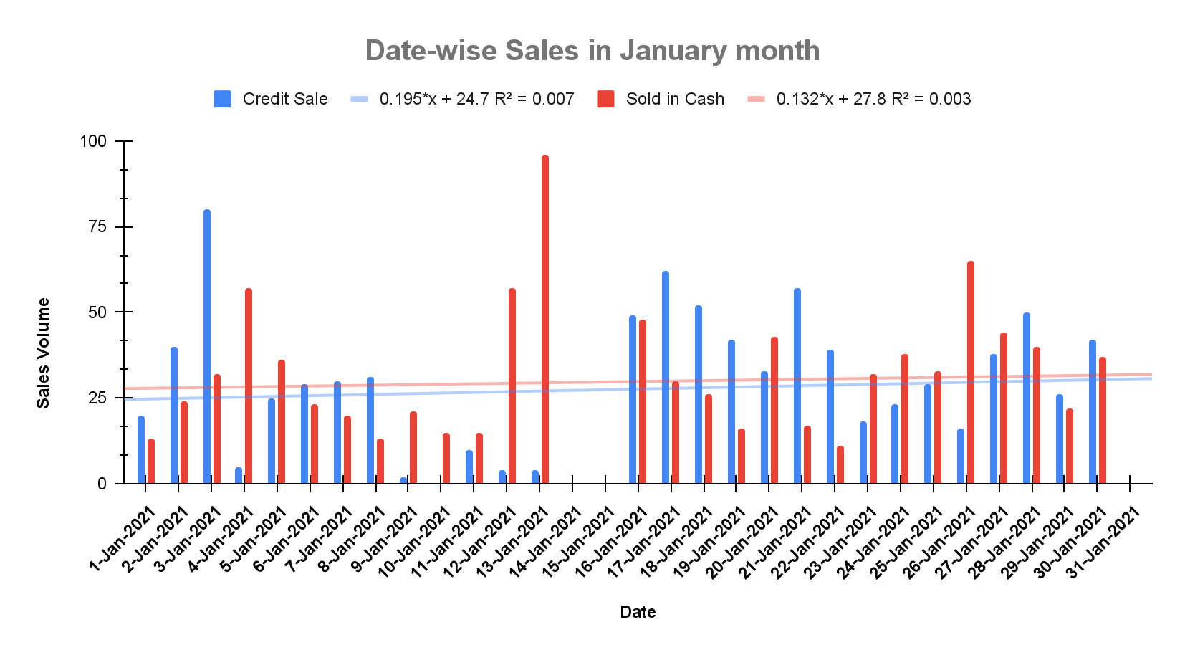
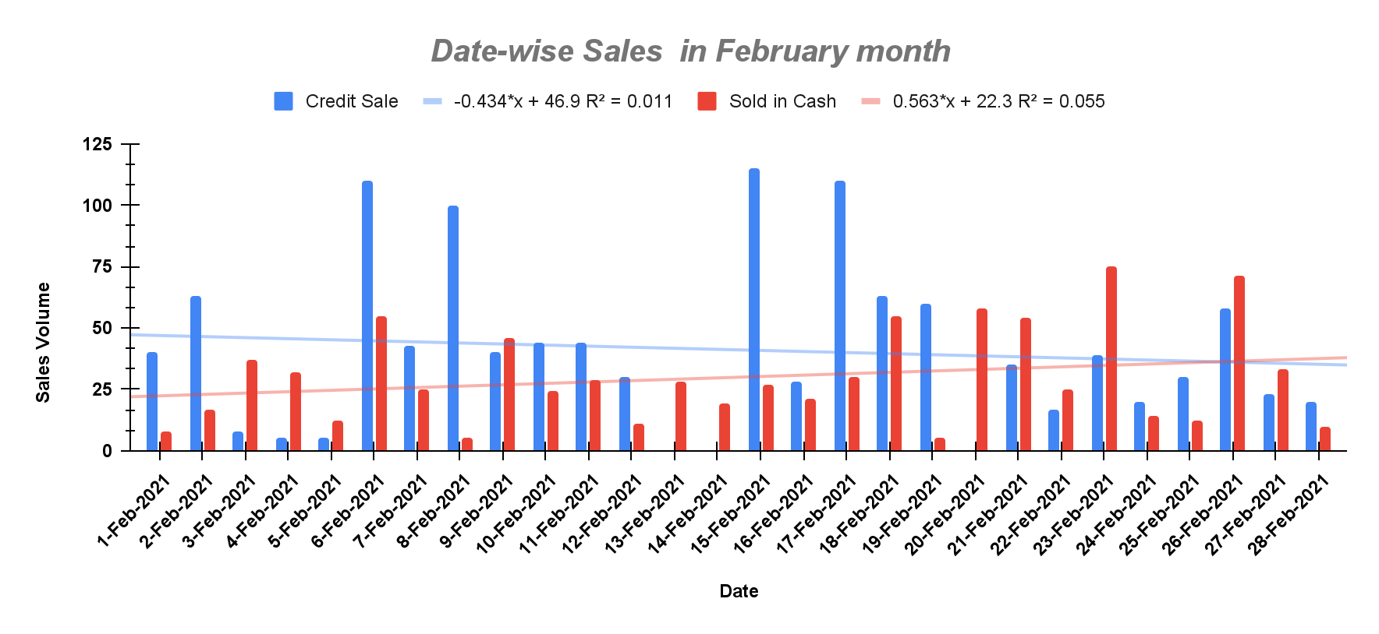
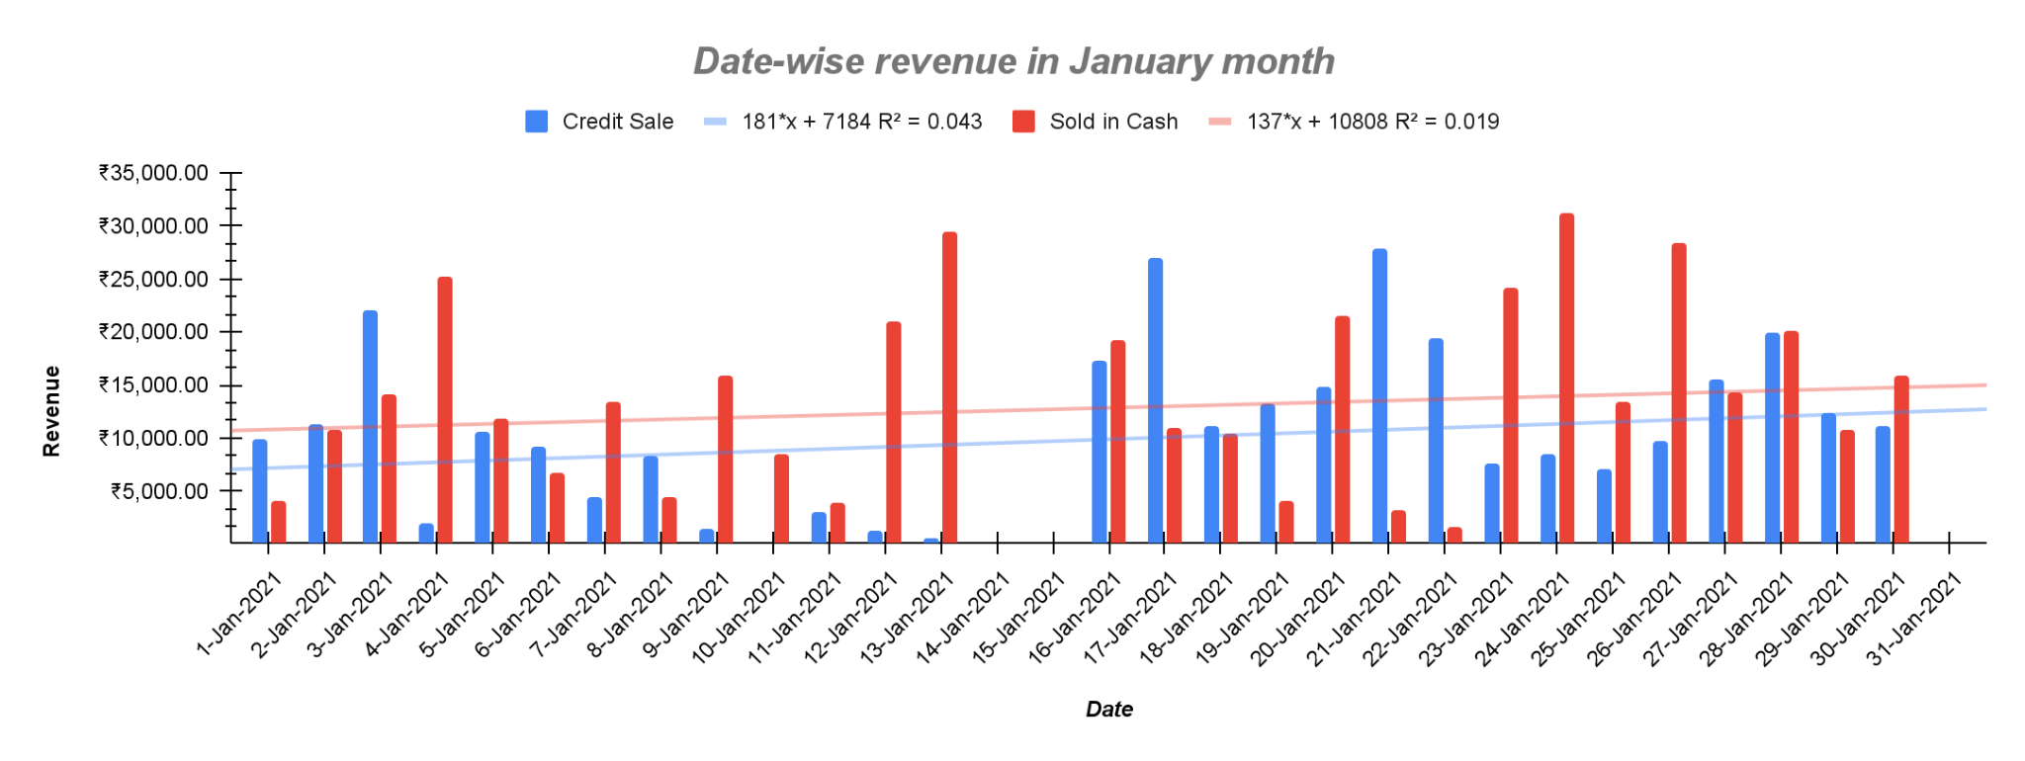
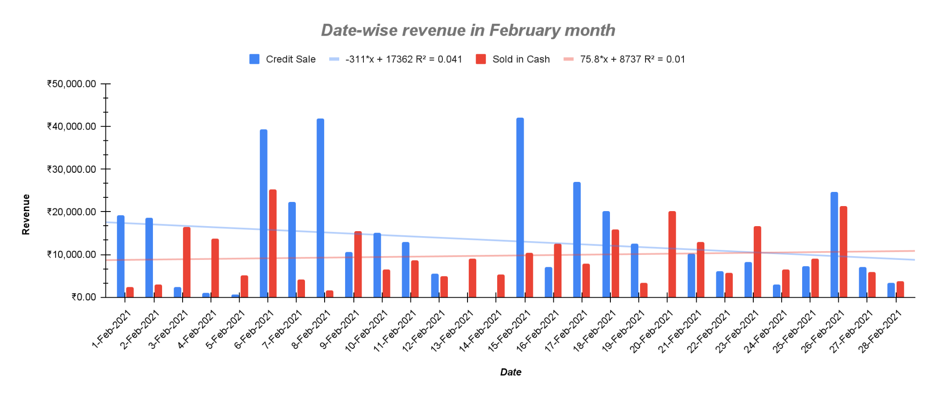
Data Analysis & Interpretation
The trendline for sales or revenue in january month is in upward direction for the both credit sales and sales in cash but in february month, it is in downward direction for credit sales and it is in like constant or upward direction for sales in cash..

Slide 8
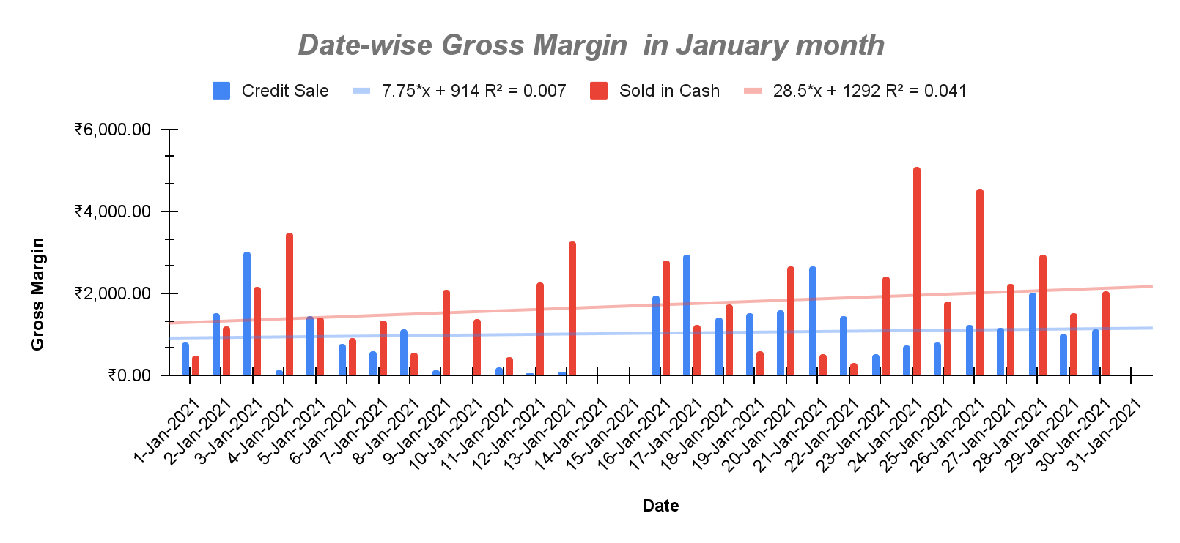
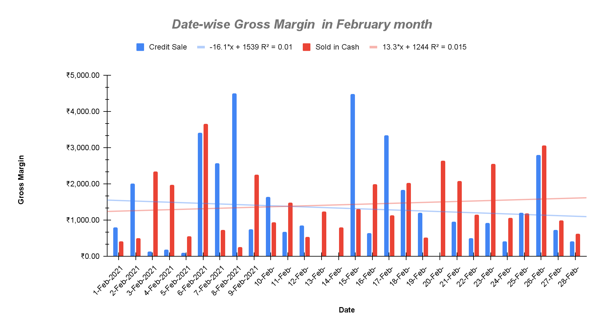
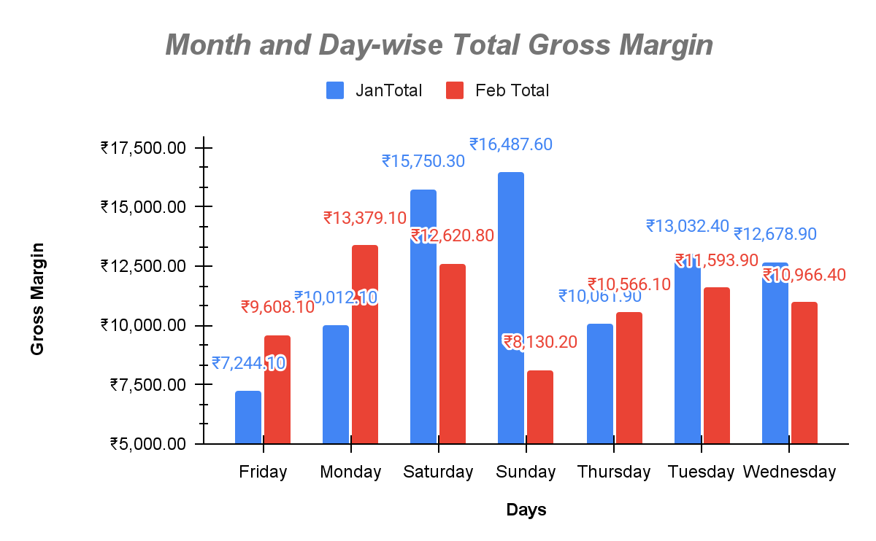
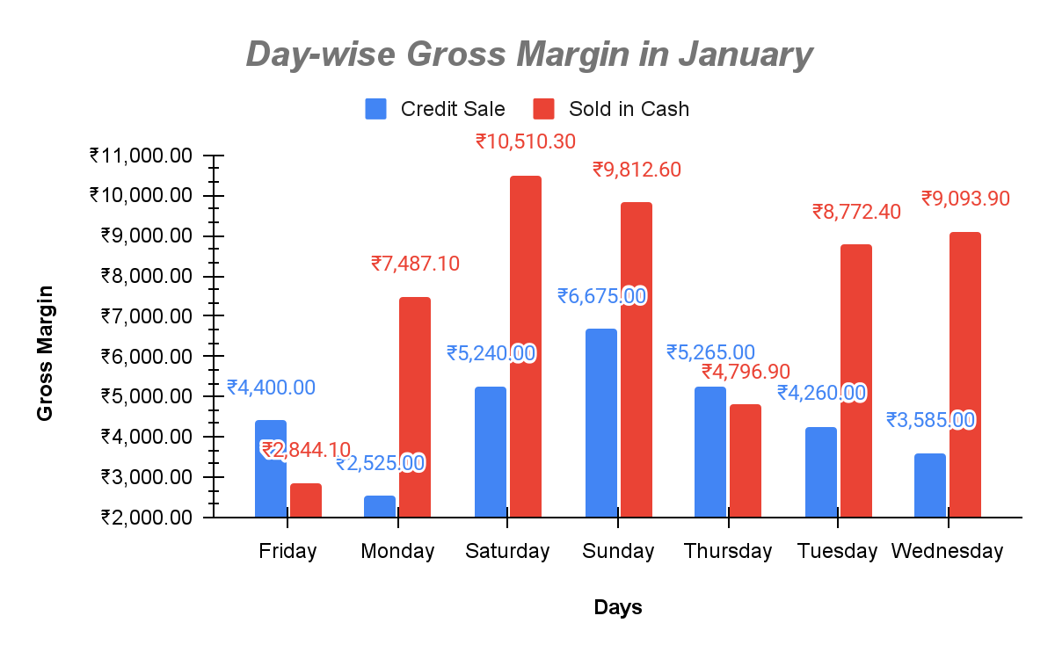
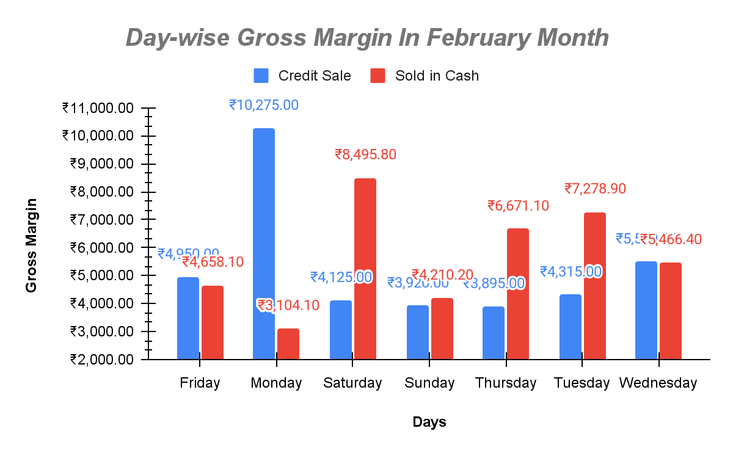
Data Analysis & Interpretation
The trendline for Gross margin in january month is in upward direction for the both credit sales and sales in cash but in february month, it is in downward direction(for credit sales) but it is in upward direction for sales in cash.
Saturday, Sunday, Monday , Tuesday are the most selling , revenue generating and profitable days , so in those days shop should be opened with enough stocks , working staffs always.

Slide 9
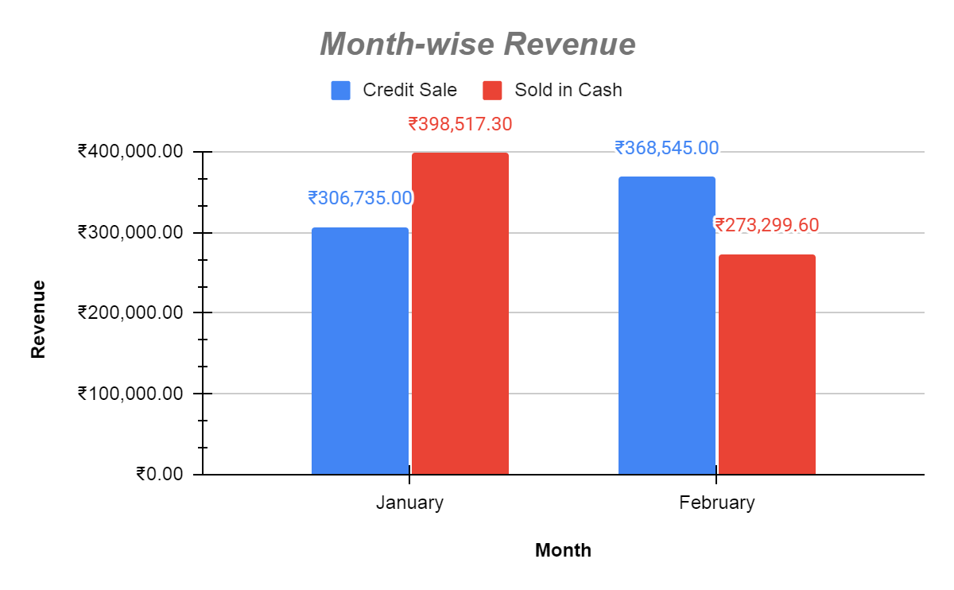
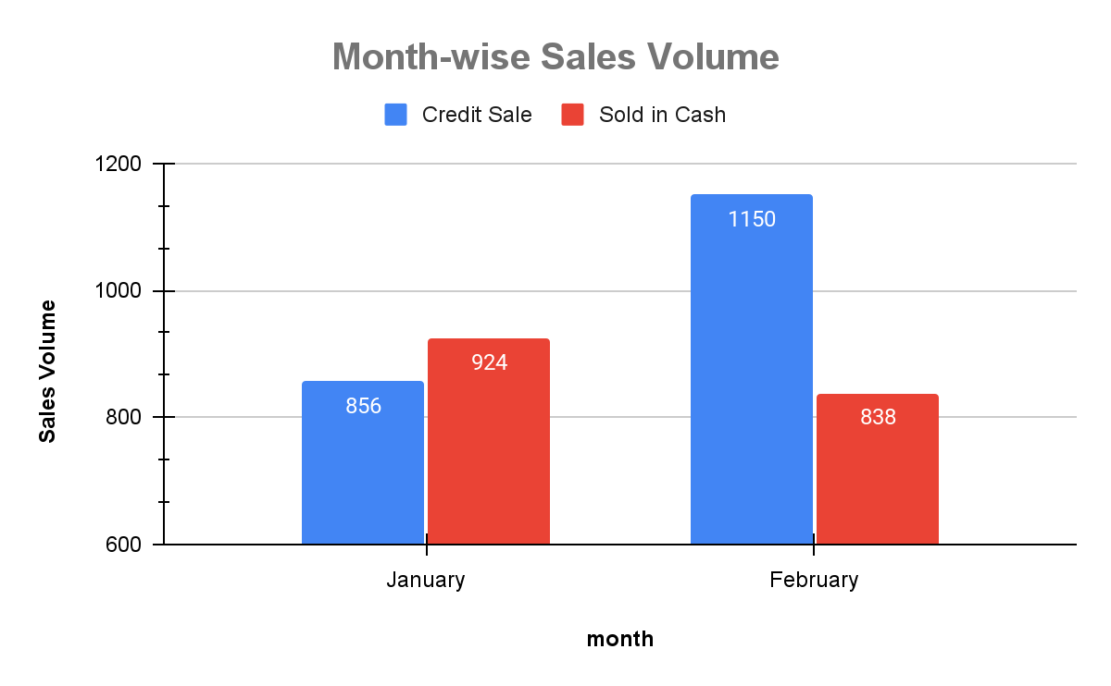
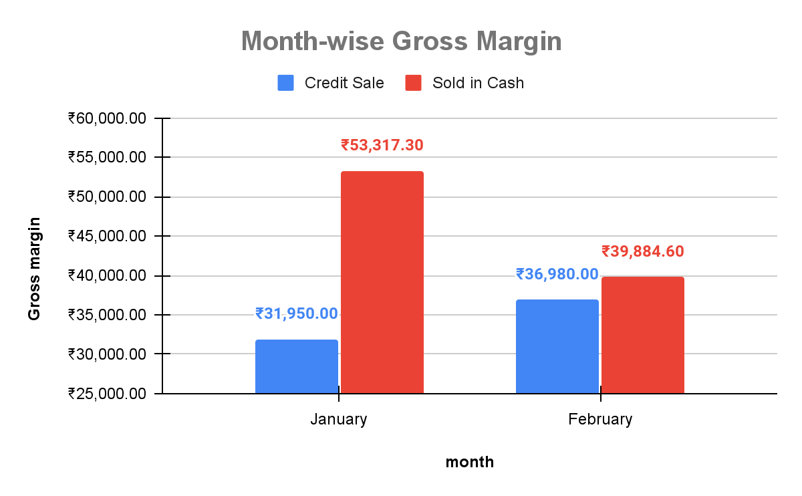
Data Analysis & Interpretation
In January month , revenue from Cash sales is 29.92% higher than credit sales revenue.
In February month , revenue from Credit sales is 34.85% higher than Cash sales revenue.
In January month , Volume of Cash sales is 7.94% higher than credit sales.
In February month ,Volume of Credit sales is 37.23% higher than Cash sales.
The total gross margin in Sales in cash is always higher than credit sales .
In January month , gross margin is 66.88% higher than credit sales .
In February month , gross margin is 7.85% higher than credit sales .

Slide 10
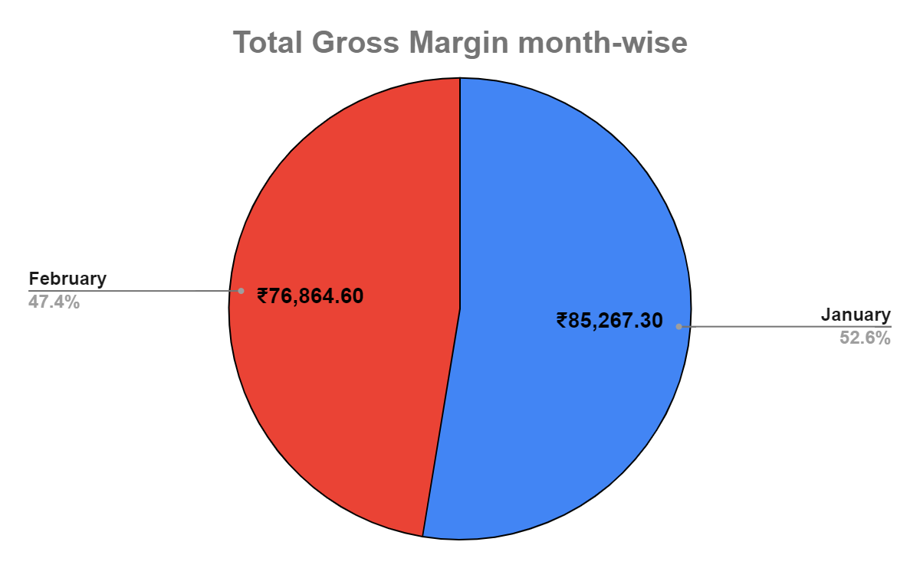
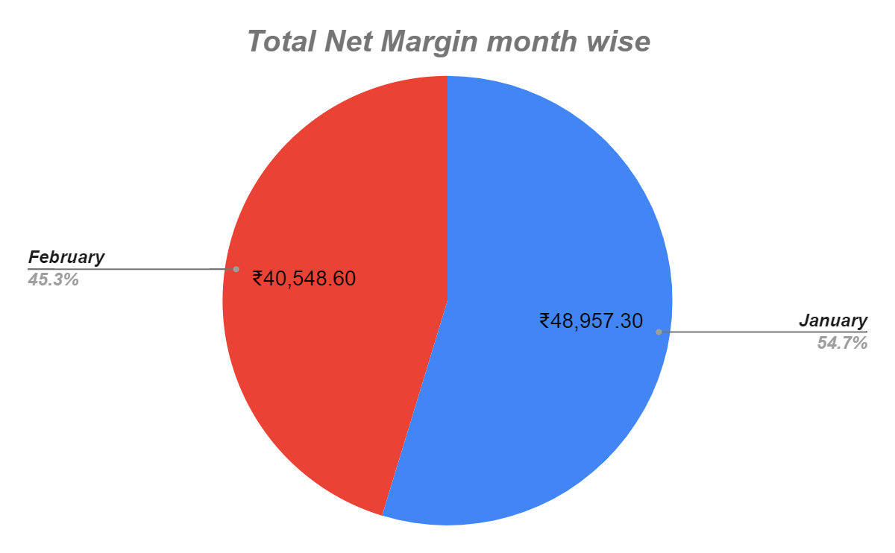
Data Analysis & Interpretation
Average Gross Margin in January and February month are 12.09% and 11.98% respectively.
January month is more gross profit generating month than february.
Average Net Margin in January and February month are 6.94% and 6.32% respectively.
January month is more net profit generating month than february.

Slide 11
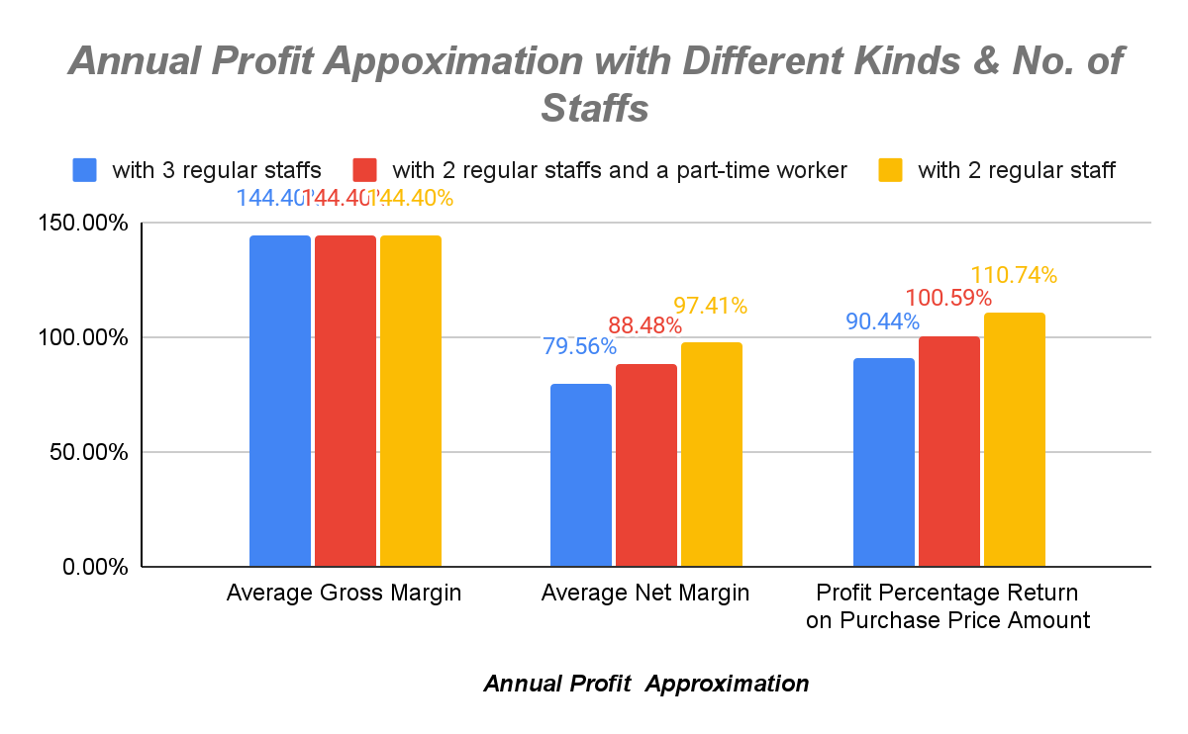
Data Analysis & Interpretation
Average Net Margin | with 3 regular staffs | with 2 regular staff | with 2 regular staffs and a part-time worker
month
January | 6.94% | 8.36% | 7.65%
February | 6.32% | 7.88% | 7.10%
Profit Percentage Return on Purchase Price Amount(monthly) | with 3 regular staffs | with 2 regular staff | with 2 regular staffs and a part-time worker
January | 7.90% | 9.51% | 8.70%
February | 7.18% | 8.95% | 8.06%
Average Net Margin will be increased by 8.93% for 2 regular & 1 part-time staffs and by 17.86% for only 2 staffs from the old staff model which have 3 regular staffs.
Annual Profit Percentage Return on purchase Price amount is strictly higher than any other investments with interest rate of 15-20% annually.
Annual Approximation | with 3 regular staffs | with 2 regular staff | with 2 regular staffs and a part-time worker
Average Gross Margin | 144.40% | 144.40% | 144.40%
Average Net Margin | 79.56% | 97.41% | 88.48%
Profit Percentage Return on Purchase Price Amount | 90.44% | 110.74% | 100.59%

Slide 12
Recommendations
Try to do all possible credit sales transactions in online mode and take full payment by dividing it into small parts that can be paid within a fixed time interval like 3 days till the completion of payment(like recurring deposit or loan payment) with help of some online available apps like Bharatpay etc, which also give interest on cash on daily basis which increases the total net profitability of the business as well as future loan eligibility.
If first recommendation is profitable for the business then one of employees(who is hired for mainly collection of Payments for the credit sales) can be laid off or hired as a part-time worker if required ; which will increase average net profit margin.
Try to put more effort to sell in semi-retail (sell comparatively large amount of products then normal asked retail sales with small decrease of 0.5-2% in selling price of retail sales) mode as retail sales has more gross margin(7.85-66.88%) then credit sales and all retail sales are done on cash mode also which maintains the cash liquidity in business.
Top common selling salts with their weights in terms of total gross margin ,total sales volume & revenue are Sungold 25,Loose salt 25,Loose salt 50,Tata salt 25, Tata salt 50,Saffola 25 ,Saffola 50,Black salt 25,Black salt 50,so these salts should be in stocks always.
Try to check and maintained all stocks in 15 days to avoid stock out and note down the small stocks and try to sell similar but different available stocks instead of that small stocks to maintain all customers.
Saturday, Sunday, Monday , Tuesday are the most selling , revenue generating and profitable days , so in those days shop should be opened with enough stocks , working staffs always.

